Slide 1
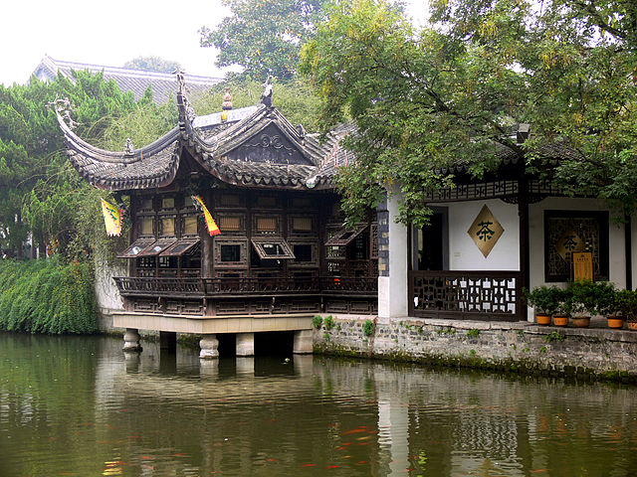
Who is testing the mocks?
an assume-verify-approach
Andreas Leidig, Robin Danzinger

Slide 2
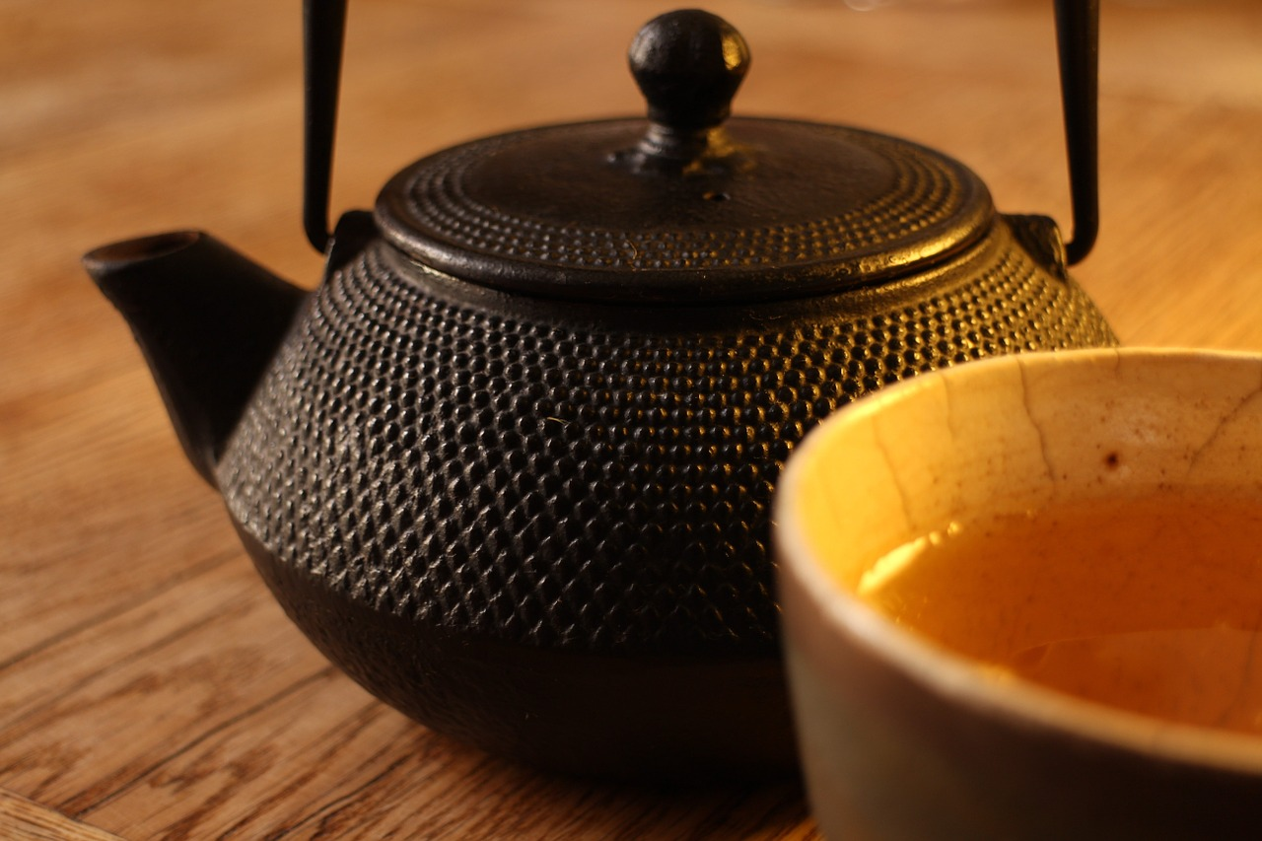
agenda
Motivation
Idiosyncrasies of Javascript
Test Doubles
Assume-Verify-Approach
Chadojs
Discussion

Slide 3

Motivation
Test approach
London School
Integrated Tests
Unit Tests
Idiosyncrasies of Javascript
Dynamic
Prototype
Simple
Notes:
2 aspects
Test approach – technical reasons

Slide 4

Integrated Tests are a Scam (2010)
„Integrated tests are a scam—a self-replicating virus that threatens to infect your code base, your project, and your team with endless pain and suffering.“
http://blog.thecodewhisperer.com/permalink/integrated-tests-are-a-scam
Notes:
I use the term integrated test to mean any test whose result (pass or fail) depends on the correctness of the implementation of more than one piece of non-trivial behavior.
Unit Tests often not enough. Defects in software although high coverage with unit tests -> „Let‘s write integrated tests!“
BANG - Combinatory explosion.
----- Besprechungsnotizen (16.05.16 18:24) -----
Testing your functions in an integrated runtime
vs.
Test that your modules work even when integrated

Slide 5

Integrated Tests are a Scam (2010)
Integrated tests
are not the same as
integration tests

Slide 6
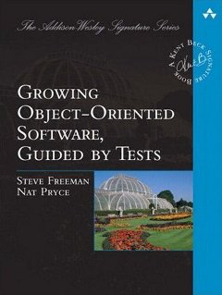
Outside-In „London School“ (2009)
http://www.growing-object-oriented-software.com
Notes:
Inside-Out – Starts from the innermost unit
Risks -> overengineering
-> doesn‘t meet client‘s requirements
Outside-In – starts from the clientside
Tests are driven by the client usage

Slide 7
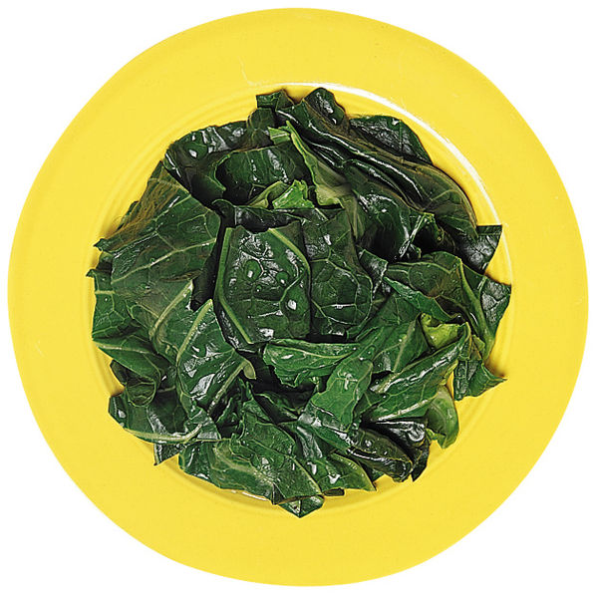
Idiosyncrasies of Javascript
Mititei
is much more wholesome,
if you replace it right before serving
with spinach.
Notes:
Your girlfriend orders Mititei
You want her to have healthy food
The waiter brings Mititei
She looks away – and suddenly (magically) it becomes spinach
Cool / Spooky

Slide 8
Idiosyncrasies of Javascript
dynamic language
create objects on the fly
change objects on the fly
functions are first class objects
very powerful, but can be very error-prone!

Slide 9
Idiosyncrasies of Javascript
code example

Slide 10
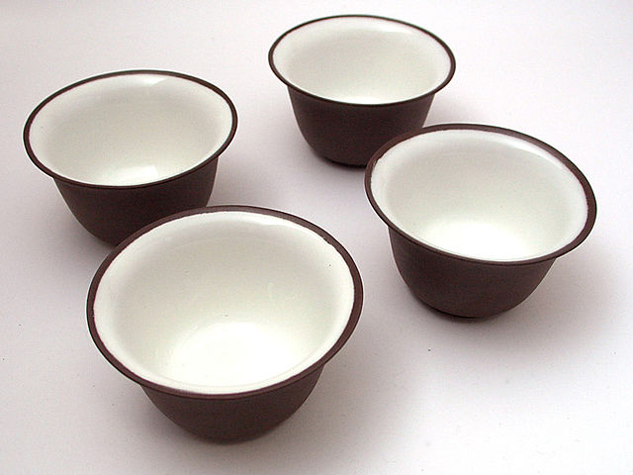
Back to now
we don‘t want integrated tests
but integration tests
we like London School
many isolated tests
„heavy mocking“

Slide 11
agenda
Motivation
Idiosyncrasies of Javascript
Test Doubles
Assume-Verify-Approach
Chadojs
Discussion

Slide 12
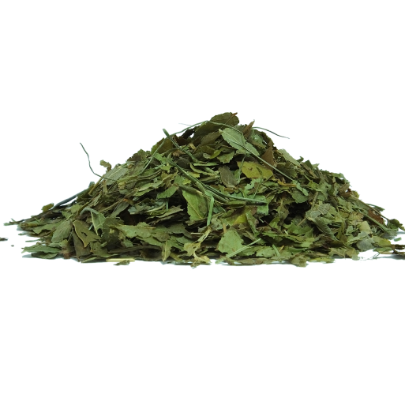
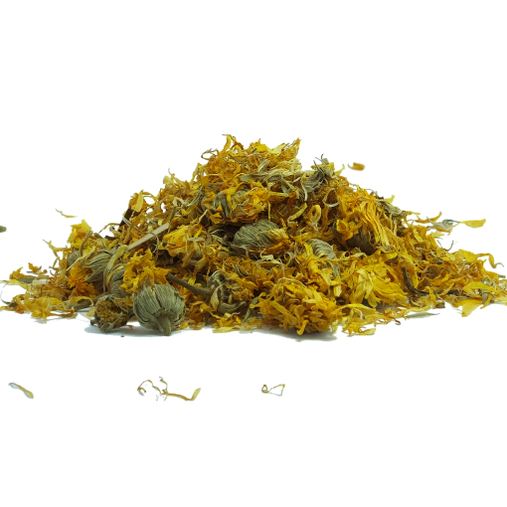
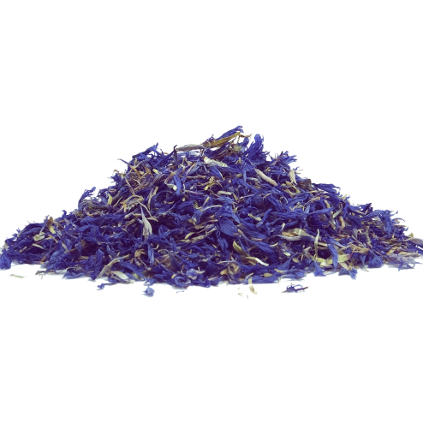
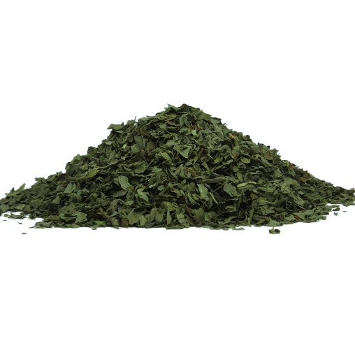
Test Doubles
in everyday use often no precise distinction
stub, fake, spy, mock
Notes:
Generic Term for replacing production code inside tests
JAVA
JAVA
JAVA
JAVA
JAVA
JAVA
JAVA
JAVA

Slide 13
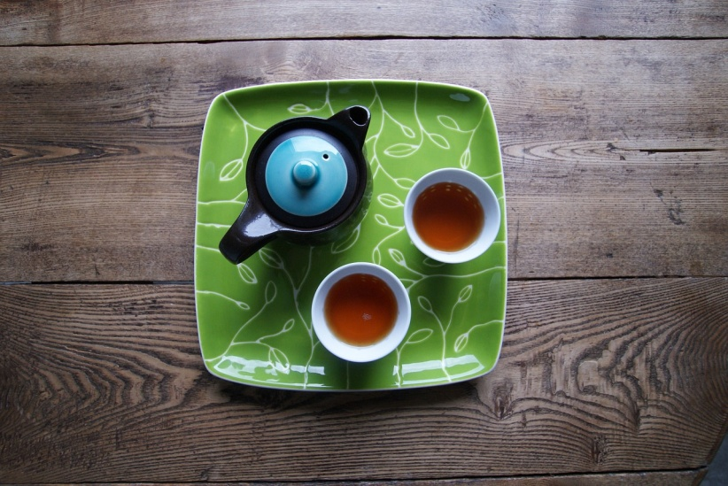
SUT (KlassA)
public class KlassA {
private KlassB klassB;
public KlassA(KlassB klassB) { this.klassB = klassB; }
public boolean anInterestingMethod() {
return this.klassB.helpDoTheWork() < 10;
}
}

Slide 14
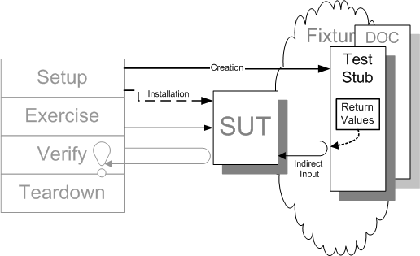
Stub
Image Source: http://xunitpatterns.com/Test%20Stub.html - With kind permission by Gerard Meszaros

Slide 15
Stub
@Test
public void withMockitoStub() {
KlassB stub = Mockito.mock(KlassB.class);
assertThat(new KlassA(stub).anInterestingMethod(), is(true));
}

Slide 16
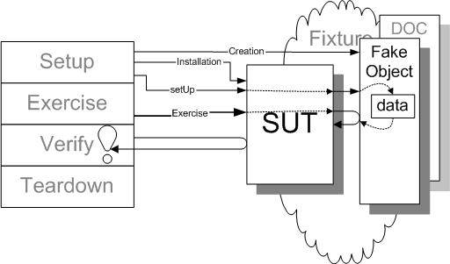
Fake Object
Image Source: http://xunitpatterns.com/Fake%20Object.html - With kind permission by Gerard Meszaros

Slide 17
Fake Object
@Test
public void withFake() {
KlassB fake = new KlassB() {
@Override
public int helpDoTheWork() { return 1; }
};
assertThat(new KlassA(fake).anInterestingMethod(), is(true));
}

Slide 18
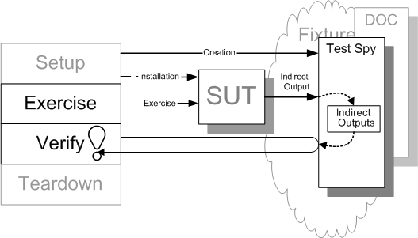
Spy
Image Source: http://xunitpatterns.com/Test%20Spy.html - With kind permission by Gerard Meszaros

Slide 19
Spy
public static class Spy extends KlassB {
int wasCalled;
@Override
public int helpDoTheWork() { this.wasCalled++; return 1; }
}
@Test
public void withManualSpy() {
Spy spy = new Spy();
new KlassA(spy).anInterestingMethod();
assertThat(spy.wasCalled, is(1));
}

Slide 20
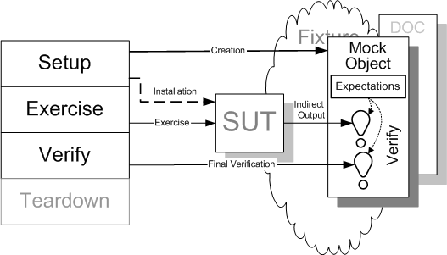
Mock
Image Source: http://xunitpatterns.com/Mock%20Object.html - With kind permission by Gerard Meszaros

Slide 21
Mock
@Test
public void withMockitoMock() {
KlassB mock = Mockito.mock(KlassB.class);
new KlassA(mock).anInterestingMethod();
Mockito.verify(mock).helpDoTheWork();
}

Slide 22
Test Doubles
stub, fake, spy, mock
How do you use test doubles?
Notes:
Sometimes a test asserts methods of the mock.

Slide 23

Useless Test
@Test
public void testTheMock() {
KlassB klassB = Mockito.mock(KlassB.class);
// bla bla bla
// bla bla bla
// bla bla bla
assertThat(klassB.helpDoTheWork(), is(0));
}

Slide 24

Test Doubles
test
assumption 1
„menu no. 42“
waiter
mocked
chef
assumption 2

Slide 25
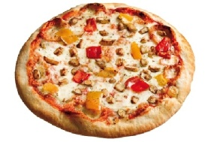
Test Doubles
test
„menu no. 42“
mocked
chef
real app
„menu 42“
real
chef
Notes:
More problem in dynamic languages
But also in java
Return boolean as errorflag. True means error or no error (successfull operation)
Bug in a core service - > talk to core team -> yes we know but we can‘t change it
Because all units, which are using this service have created a workaround
And when we change it, these services will break.

Slide 26
Test Doubles
test
„menu 42“
mocked
chef
real app
„menu 42“
real
chef

Slide 27
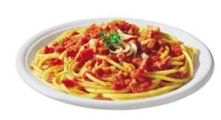
Test Doubles
test
„menu 42“
mocked
chef
unit-tests with mocks
could be mocks itself.
real app
„menu 42“
real
chef

Slide 28
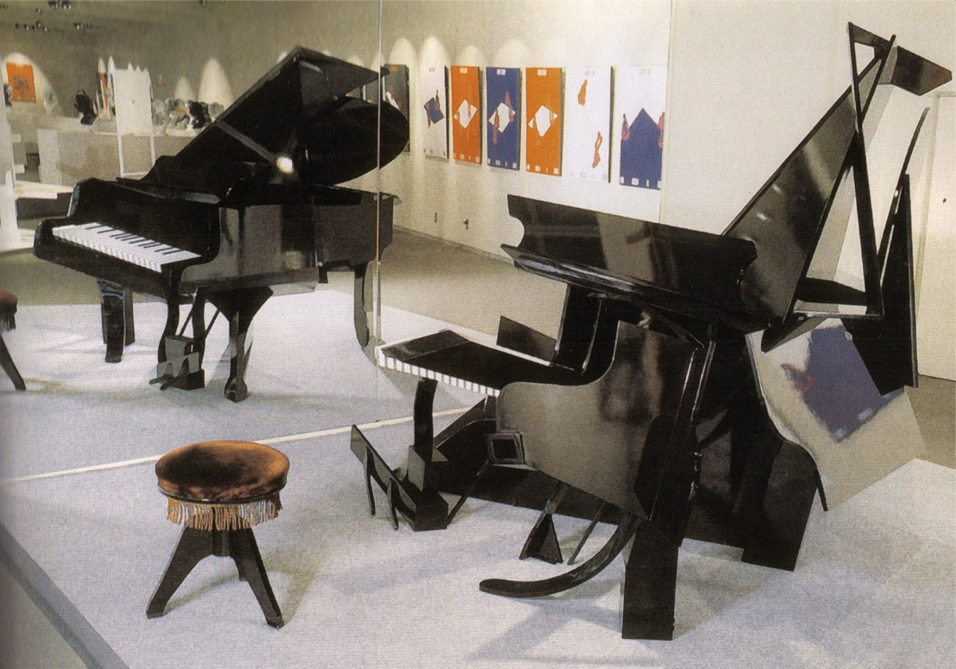
to mock = to mimic
to mock = to delude

Slide 29
If we want to test with mocks successfully we have to ensure that our mocks work under realistic assumptions
Are the assumptions correct?
Does the real object behave as we assume?

Slide 30
agenda
Motivation
Idiosyncrasies of Javascript
Test Doubles
Assume-Verify-Approach
Chadojs
Discussion

Slide 31
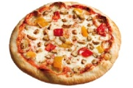
Assume-Verify-Approach
testdouble
waiter
„menu 42“
test
waiter
Assume
chef
„menu 42“
test
chef
Verify

Slide 32
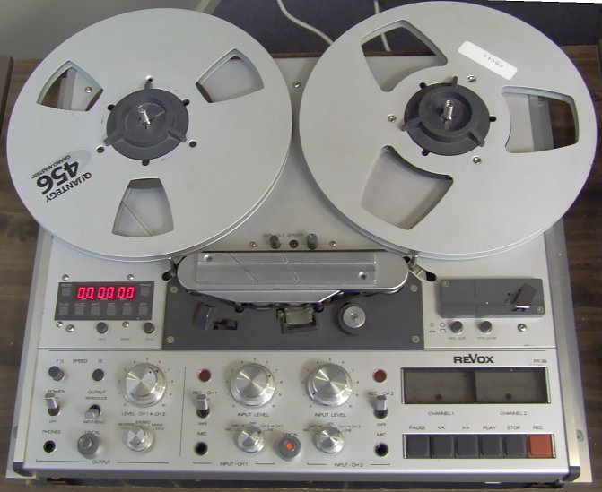
Assume-Verify-Approach
Record all assumptions and verifications
Test
Assume
Test
Assume
Test
Assume
Verify
…
Assume
Verify
Test
…

Slide 33
Assume-Verify-Approach
Match all assumptions and verifications
Does for every assumption exist at least one verification?
Does for every verification exist at least one assumption?
Assume
Verify
Assume
Assume
Verify
Assume
Assume
Assume
Verify
Verify
Assume
Verify
Verify
Assume
Assume

Slide 34
agenda
Motivation
Idiosyncrasies of Javascript
Test Doubles
Assume-Verify-Approach
Chadojs
Discussion

Slide 35
code example

Slide 36
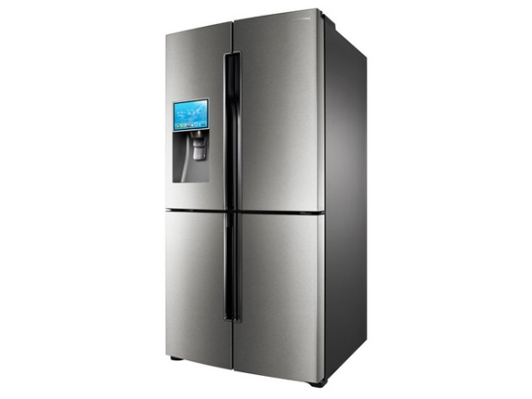
Restaurant simulation
I order a menu
I take the order
I fetch the ingredients and cook
client
waiter
chef
pantry

Slide 37
Restaurant simulation
I order a menu
I take the order
I fetch the ingredients and cook
„pizza tonno“
„142“
„ingredients“
pizza tonno
pizza tonno
ingredients
client
waiter
chef
pantry

Slide 38
code example

Slide 39
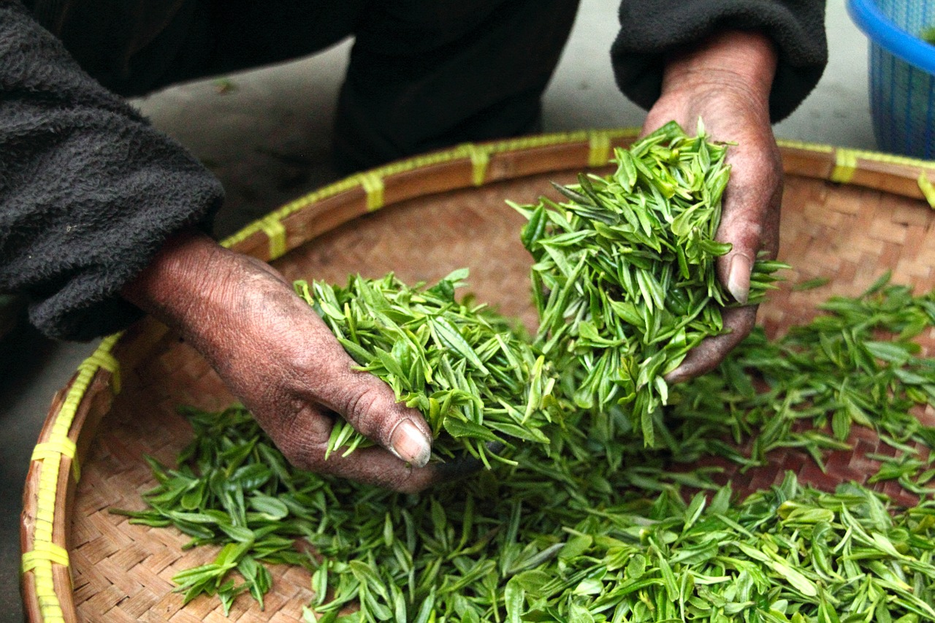
Summary
high coverage by isolated tests
interaction of units should be tested too
pairwise integration
assume-verify testing with chado

Slide 40


Slide 41
Links
Chadojs on Github: https://github.com/robindanzinger/chadojs
J.B.Rainsberger: Integrated tests are a scam: http://blog.thecodewhisperer.com/permalink/integrated-tests-are-a-scam
bogus for ruby: https://github.com/psyho/bogus
midje for clojure: https://github.com/marick/Midje

Slide 42
Sources
https://pixabay.com/de/teekanne-trinken-pokal-getr%C3%A4nke-516024/
https://pixabay.com/de/fr%C3%BChling-hintergrund-gr%C3%BCn-gras-315247/
https://pixabay.com/de/tee-bauernhaus-hand-frisch-623796/

Slide 43
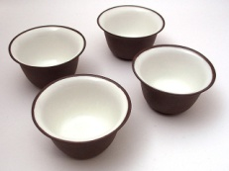


Sources
„Chapei“ von Original uploader was Commonsenses at ja.wikipedia - Originally from ja.wikipedia; description page is/was here.. Lizenziert unter CC BY-SA 3.0 über Wikimedia Commons - https://commons.wikimedia.org/wiki/File:Chapei.jpg#/media/File:Chapei.jpg
„Monk in Tashilhunpo3“ von Antoine Taveneaux - Eigenes Werk. Lizenziert unter CC BY-SA 3.0 über Wikimedia Commons - https://commons.wikimedia.org/wiki/File:Monk_in_Tashilhunpo3.jpg#/media/File:Monk_in_Tashilhunpo3.jpg
„Teahouse-Nanjing“ von Gisling - Eigenes Werk. Lizenziert unter CC BY 3.0 über Wikimedia Commons - https://commons.wikimedia.org/wiki/File:Teahouse-Nanjing.jpg#/media/File:Teahouse-Nanjing.jpg

Slide 44
Sources
https://pixabay.com/get/ef3cb0082afd1c22d2524518a33219c8b66ae3d11fb2134590f3c279/teapot-691729_1280.jpg
„Revox-reel-to-reel“ von User Iain from en:Wikipedia, 06:55, 16 June 2006 (UTC) - My Original Photo. Lizenziert unter Gemeinfrei über Wikimedia Commons - https://commons.wikimedia.org/wiki/File:Revox-reel-to-reel.JPG#/media/File:Revox-reel-to-reel.JPG
„Optische illusion piano“ von ​German Wikipedia Benutzer Roger. Lizenziert unter GFDL über Wikimedia Commons - https://commons.wikimedia.org/wiki/File:Optische_illusion_piano.jpg#/media/File:Optische_illusion_piano.jpg

Slide 45
Sources
https://pixabay.com/get/ee32b5072af21c22d2524518a33219c8b66ae3d11fb2144396f5c37f/bilberry-774826_1280.png
https://pixabay.com/get/ee32b50729f21c22d2524518a33219c8b66ae3d11fb2144396f7c978/flowers-774816_1280.png
https://pixabay.com/get/ee3db3082efc1c22d2524518a33219c8b66ae3d11fb2144396f5c97a/dried-flower-782768_1280.png
https://pixabay.com/get/ee32b5072af71c22d2524518a33219c8b66ae3d11fb2144396f3c97b/dried-774823_1280.png

Slide 46
Sources
https://pixabay.com/static/uploads/photo/2015/07/05/09/44/tableware-832035_640.jpg
https://pixabay.com/get/e837b20b20f6063ed1584d05fb0938c9bd22ffd41db7124497f3c871a3/tea-1234827_1280.jpg

